Slide 1
Speech Recognition
http://electronics.howstuffworks.com/gadgets/high-tech-gadgets/speech-recognition.htm/printable
http://www.explainthatstuff.com/voicerecognition.html

Slide 2
Types of Audio
Two major types of digital sound:
Sampled sound: digital recording of previously existing analog sound wave.
File contains numeric values to describe the amplitude of the sound wave at a particular instant.
Used to capture and edit naturally-occurring sounds.
Synthesized sound: new sound generated by the computer.
File contains instructions the computer uses to reproduce the sound.
Used to:
Create original compositions
Produce novel sound effects.

Slide 3
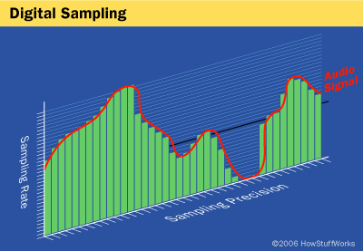
Speech to Data
analog-to-digital converter (ADC) translates an analog wave from your microphone into digital data that the computer can understand. It samples (digitizes) the sound by taking precise measurements of the wave at the recording sample frequency.

Slide 4
People pause their airflow when saying certain consonants like "p" or "t." The program then matches these segments to known phonemes in the appropriate language.
A phoneme is the smallest element of a language -- a representation of the sounds we make and put together to form meaningful expressions. There are roughly 40 phonemes in the English language.

Slide 5
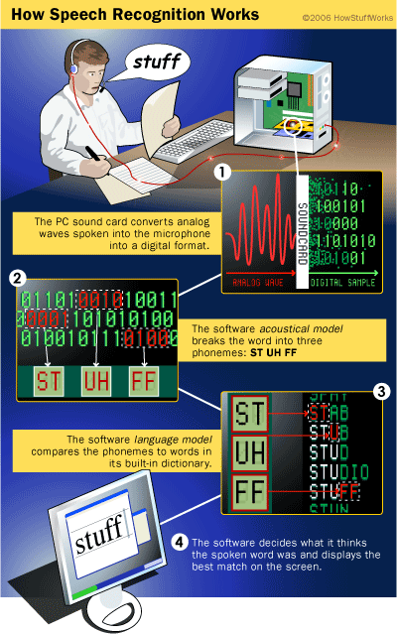
Hidden Markov Model
1. Has finite internal states that generate a set of external events (observations) 2. The internal state changes are invisible (hidden) to a viewer outside the system 3. The current state is always dependent on the immediate previous state only (Markov process)
http://setosa.io/ev/markov-chains/

Slide 6
Interesting Examples
http://cecas.clemson.edu/~ahoover/ece854/refs/Ramos-Intro-HMM.pdf

Slide 7
How to turn spoken sounds into written words
Simple pattern matching (where each spoken word is recognized)
Pattern and feature analysis (where each word is broken into bits and recognized from key features, such as the vowels it contains)
Language modeling and statistical analysis (in which a knowledge of grammar and the probability of certain words or sounds following on from one another is used to speed up recognition and improve accuracy)
Artificial neural networks (brain-like computer models that can reliably recognize patterns, such as word sounds, after exhaustive training).

Slide 8
Issues
Homonyms
Background noise
Syntax (the grammatical structure of language)
Semantics (the meaning of words)

Slide 9
Applications
In-car systems – Apple CarPlay
Android Audio
People with disabilities
What others can you think of?

Slide 10
Amazon Alexa
https://hackernoon.com/alexa-skills-and-intents-be8886645ff
https://www.pluralsight.com/guides/node-js/amazon-alexa-skill-tutorial
https://blog.kit.com/build-an-alexa-bot-e1342bff0465
https://developer.amazon.com/public/solutions/alexa/alexa-skills-kit/docs/supported-phrases-to-begin-a-conversation

Slide 11
Google Home
https://www.programmableweb.com/news/how-to-get-started-google-actions/how-to/2017/01/31
https://docs.api.ai/docs/guidelines-slot-filling#section-managing-yes-no-unknown-answers-with-contexts

